Slide 1
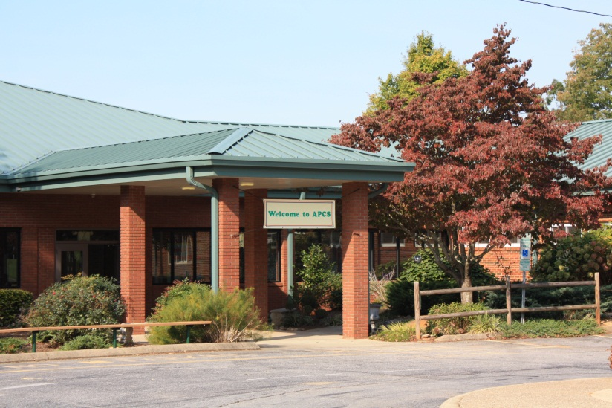
Asheville-pisgah Christian School
Delivering “GREAT” Education
90 Academy Drive
Candler, NC 28715

Slide 2
“G”
God Centered:
Integration of Faith and Community

Slide 3
“R”
Results Oriented:
Informed Decision Making

Slide 4
“E”
Environment that is Safe And Nurturing:
Invitational Climate

Slide 5
“A”
Aligned with Adventist and National Standards:
Instructional Accountability

Slide 6
“T”
Team Effort:
Collaborative and
Supportive Community

Slide 7
Asheville-Pisgah Christian School
IS
God-Centered:
Integration of Faith and Community
Results Oriented:
Informed Decision Making
Environment that is Safe and Nurturing:
Invitational Climate
Aligned with Adventist and National Standards:
Instructional Accountability
Team Effort:
Collaborative and Supportive Community

